Slide 1
OData Services
Adrian Streitz, Johannes Rank, Borys Levkovskyi

Slide 2
Prerequisites
Fundamental programming skills
Successful completion of the chapter Introduction to SAP Application Development
Recommended: Completion of the chapters HTML5, CSS & JavaScript and SAPUI5
Completion of the chapter ABAP Objects is helpful

Slide 3
Agenda
Fundamentals
Using the OData protocol in SAP
Creating and implementing OData services
Consuming OData services within SAPUI5

Slide 4
I. Fundamentals OData
OData = Open Data Protocol
HTTP-based standard for data services and data transfers
HTTP requests are transfered using Asynchronous JavaScript and XML (AJAX)
SAP Gateway allows to access SAP backend services using the OData protocol
HTTP responses contains data from the SAP system in OData format
OData services follow the principle of RESTful webservices

Slide 5
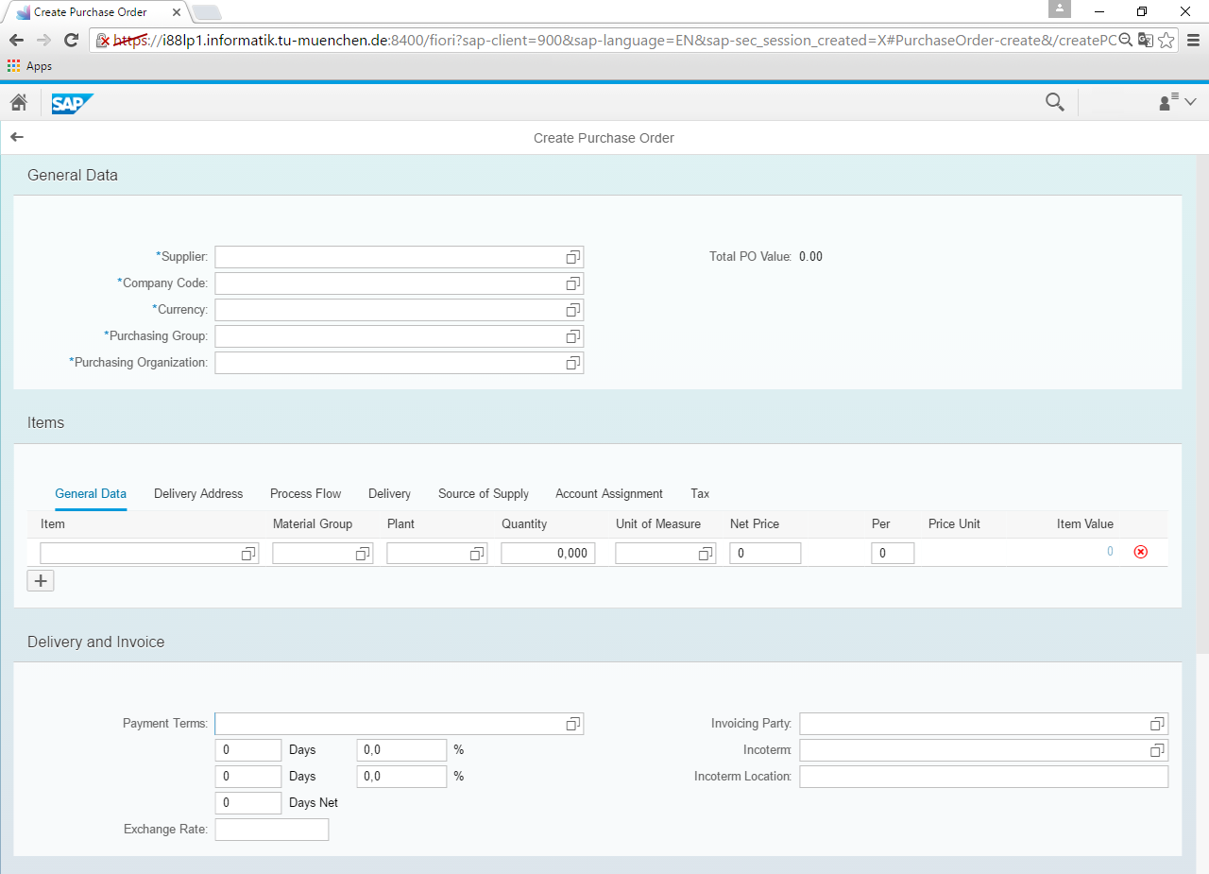
I. Fundamentals Communication with the SAP backend
AJAX
SAP
NetWeaver
AS ABAP
JSON, XML, OData

Slide 6
I. Fundamentals Asynchronous JavaScript and XML (AJAX)
Web Browser
SAP NetWeaver Application Server
Database
HTTP Request
Data Query
Query Result
HTTP Response

Slide 7
I. Fundamentals REST
REST is a form of a service-oriented architecture
Describes an architectural standard for client-server communication, based on HTTP
Important principles:
Addressability: content is represented by a Universal Resource Identifier (URI)
Different representations: a service can have different presentation formats (OData, XML, JSON, …)
Stateless: each REST message contains all necessary information for the client to understand it
Operations: services provide operations to access or change resources and information
Hypermedia: linking of information via hyperlinks

Slide 8
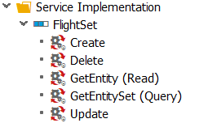
I. Fundamentals URIs
URI = Unified Resource Identifier
Every Resource of a REST WebService is represented by an URI
A Resource is an Entity like Customer, Product, Material, …
A client uses the HTTP methods to work with the resources (GET, PUT, POST, DELETE)

Slide 9
II. Using the OData protocol in SAP Architecture
SAP Annotations
OData
Atom Publishing
Atom Syndication
JSON
XML
HTTP(S)

Slide 10
II. Using the OData protocol in SAP SAP Gateway
Browser
Mobile Devices
Enterprise Software
…
…
SAP Gateway
…
SAP Business Suite
SRM
ERP
CRM

Slide 11
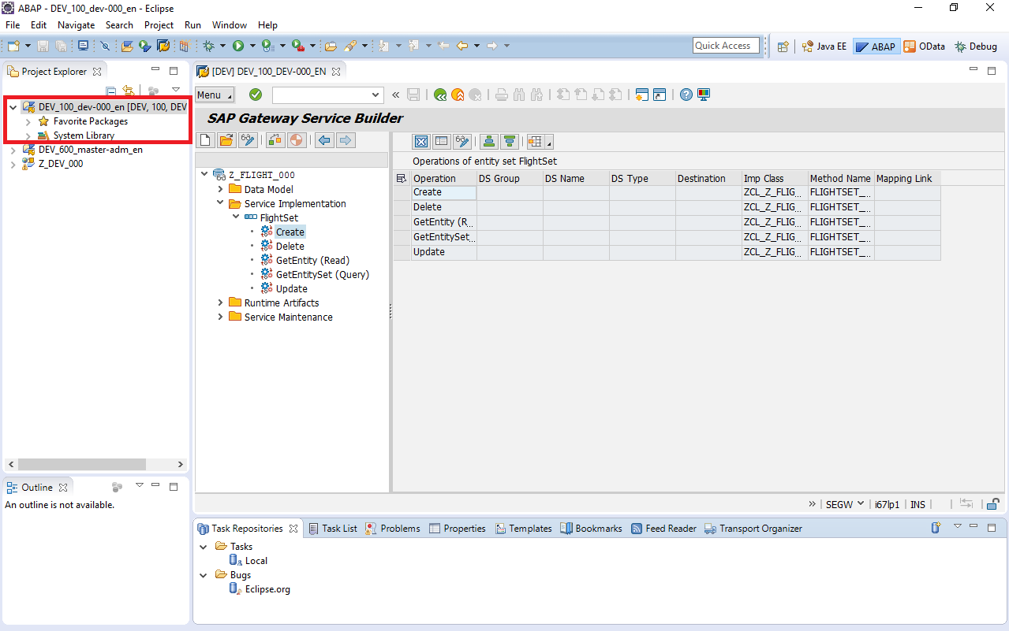
III. Creating and implementing OData services Step 1: Create a new ABAP project in Eclipse
The ABAP project is needed to access the integrated SAP GUI with Eclipse
OData services have to be implemented within an ABAP package
The integrated SAP GUI in Eclipse serves to implement, activate, and test the OData service
Eclipse can be used to implement the service logic in ABAP

Slide 12
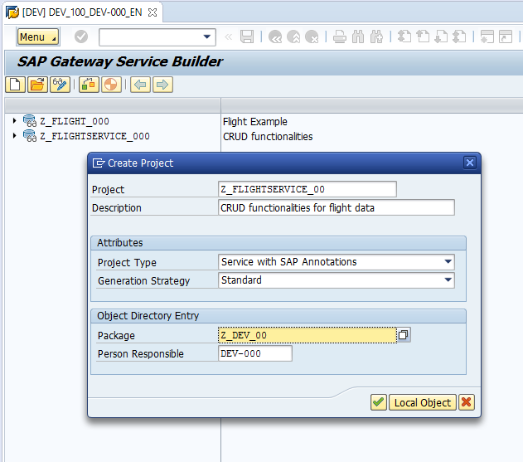
III. Creating and implementing OData services Step 2: Create a new project in the Gateway Service Builder
The project within the Gateway Service Builder serves as container for a group of services
The project generates four directories:
Data Model: Binding data models
Service Implementation: ABAP implementation of service logic
Runtime artefacts: Service documents
Service Maintenance: Managing Gateway connection

Slide 13
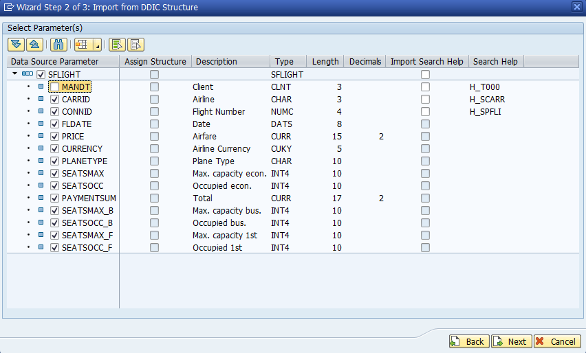
III. Creating and implementing OData services Step 3: Create data model
There are different sources to create data models (e.g. using flat files)
The most common way is using existing database objects in SAP (DDIC structures)
You have to select the fields you want to import from a DDIC structure
At least one key element has to be defined out of the field collection to serve as a unique identifier for a data entry

Slide 14
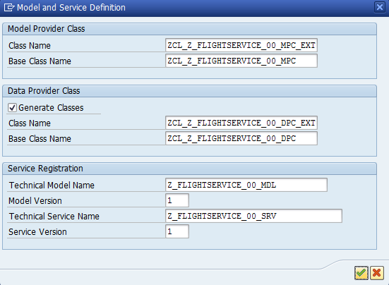
III. Creating and implementing OData services Step 4: Generate service elements
Different service elements are automatically created by the Gateway Service Builder
Four main classes are created:
…_MPC: Model definitions
…_MPC_EXT: inherits from the MPC-class, allows to overwrite service models
…_DPC: Data provider class, contains CRUD-functionalities
…_DPC_EXT: inherits from DPC class, allows to overwrite CRUD-functionalities

Slide 15
III. Creating and implementing OData services Model Provider Class (MPC)
Model Provider Class:
Defines the entity data model of a service
Is generated based on the odata model by the Service Builder
(Has to be/ is) regenerated every time the model definition is changed
Model definitions, shouldn‘t be changed
_Extension: Implementation class, inherits from the MPC-class, used for manual changes -> can be changed -> append new properties to corresponding type -> add new property to existing entity

Slide 16
III. Creating and implementing OData services Model Provider Class (MPC)
Different service elements are automatically created by the Gateway Service Builder
Four main classes are created:
Model Provider Class: Model definitions, Define()-one for each odata artifact (entity types, complex types …) and GET_LAST_MODIFIED(). Use define() to create entity, properties etc. -> shouldn‘t be changed -Provides runtime representation of your model definition
_Extension: Implementation class, inherits from the MPC-class, used for manual changes -> can be changed -> append new properties to corresponding type
Data Provider Class: Data provider class, implements: Create, Read, Update, Delete (CRUD) and Query -> runtime representation of service implementation
_Extension: Implementation class, inherits from DPC class, allows to overwrite/ redefine methods for the DPC…. The one that is executed in odata service ->is executed in odata service

Slide 17
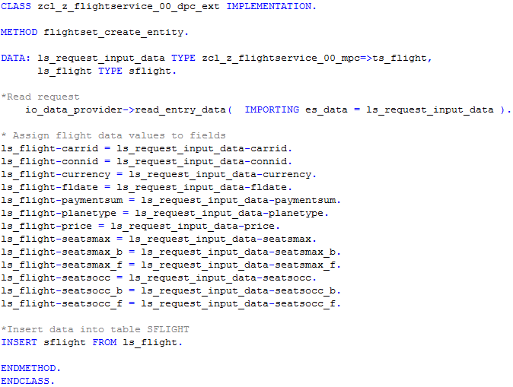
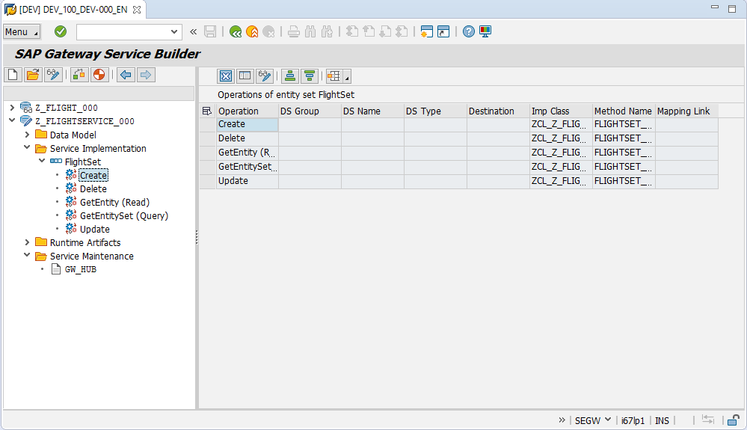
III. Creating and implementing OData services Step 5: Implement services
The CRUD functionalities have to be implemented in ABAP in order to process data operations
The coding can be done in Eclipse
Read HTTP request
Assign values to data fields
Methods to be implemented
Insert statement

Slide 18
Now you know the fundamentals of OData services.
To consolidate your knowledge, you can do tasks 1 and 2 of the OData exercise.

Slide 19
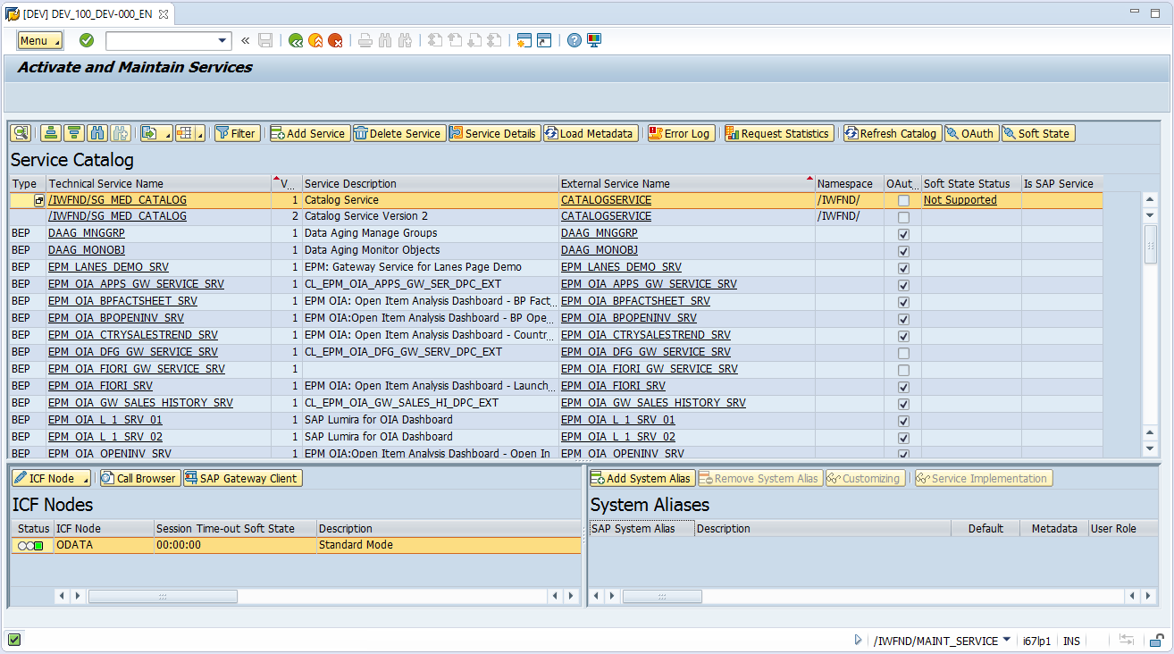
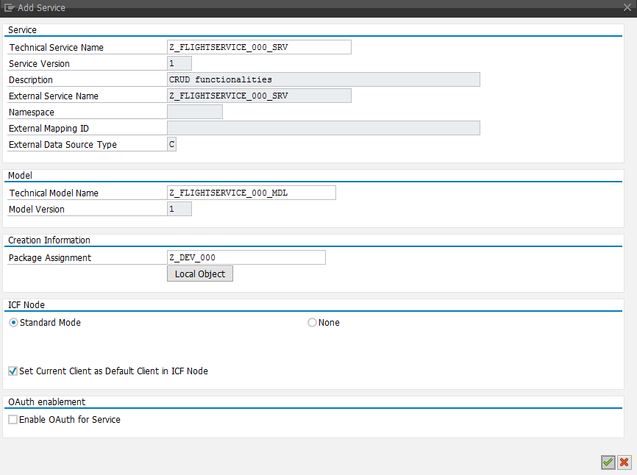
III. Creating and implementing OData services Step 6: Activate services
Call transaction /n/IWFND/MAINT_SERVICE
Add your newly created service to the service catalog

Slide 20
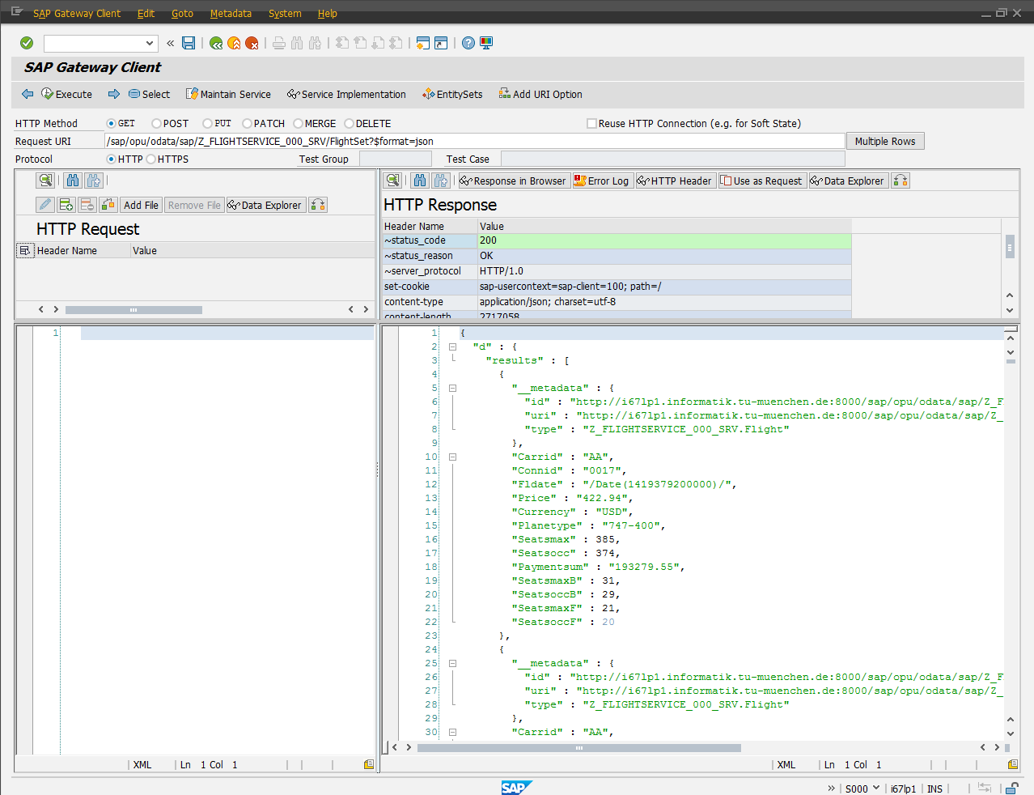
III. Creating and implementing OData services Step 7: Test services
Service URI
Use transaction /n/IWFND/MAINT_SERVICE
Select your service and call the SAP Gateway Client
With the Gateway Client, you can test services by calling the respective URI with an HTTP request
You can directly see the HTTP response in the requested format
HTTP response

Slide 21
Now you know the complete process of creating and implementing OData services.
To consolidate your knowledge, you can do task 3 of the OData exercise.

Slide 22
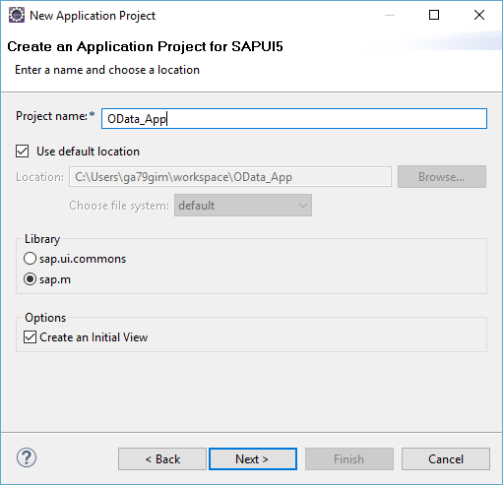
IV. Consuming OData services within SAPUI5 Step 1: Create a new SAPUI5 application project
In the Project Explorer, choose New -> Other -> SAPUI5 Application Development -> Application Project
It is recommended to create an initial view
You can choose between different formats for your initial view:
JavaScript
XML
JSON
HTML

Slide 23
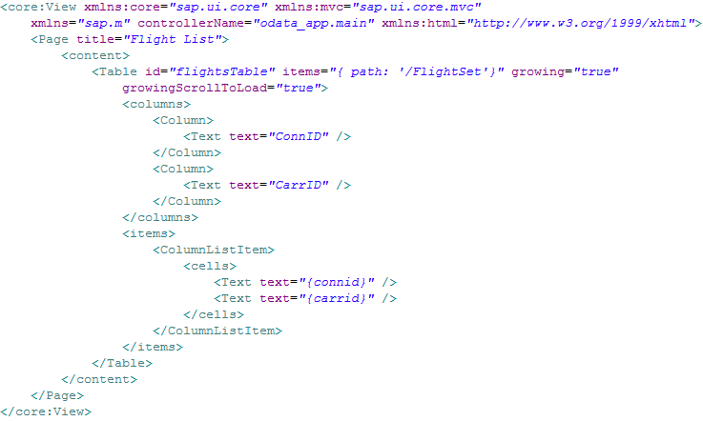
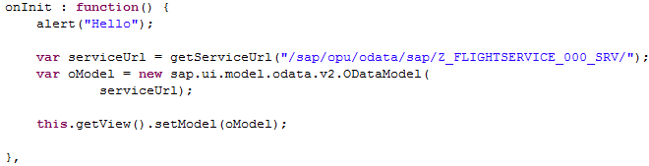
IV. Consuming OData services within SAPUI5 Step 2: Implement the service call
Definition of table columns
Path to FlightSet
Definition of table data rows
Binding data model to view
Service URI

Slide 24
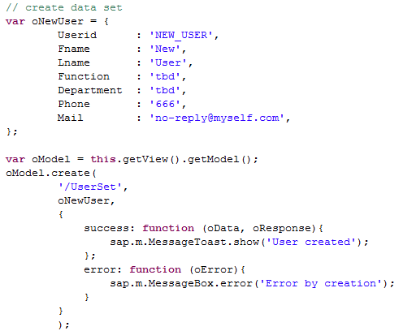
IV. Consuming OData services within SAPUI5 Step 2: Create operation
Callback functions

Slide 25
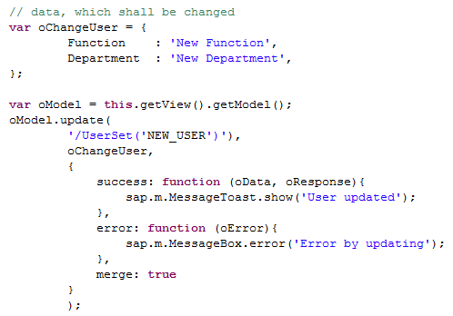
IV. Consuming OData services within SAPUI5 Step 2: Update operation
Callback functions
Is the whole data provided or only a part of it?

Slide 26
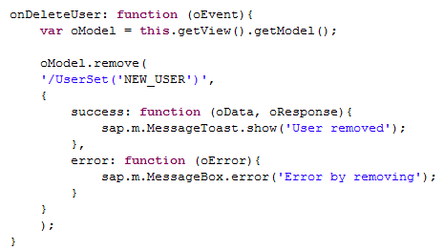
IV. Consuming OData services within SAPUI5 Step 2: Delete operation
Callback functions

Slide 27
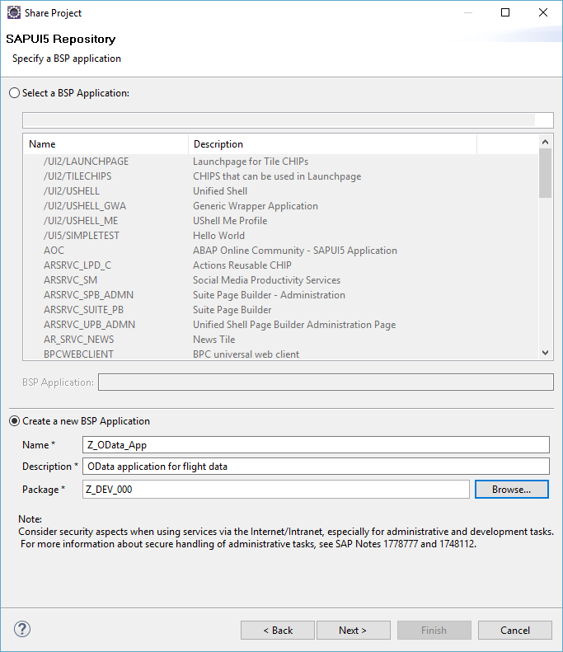
IV. Consuming OData services within SAPUI5 Step 3: Deploy the application in the SAP backend
In the Project Explorer, choose Team -> Share Project
Choose the SAPUI5 ABAP Repository as Repository object
Connect to the SAP system to which you want to deploy the application
Create a new BSP application as container for your SAPUI5 implementation
You can repeatedly submit implementation changes to the SAP backend

Slide 28
Now you know how OData services can be consumed by SAPUI5 applications.
To consolidate your knowledge, you can do task 4-6 of the OData exercise.

Slide 29
V. Advanced Implementation Topics Odata Function Imports
Odata originally intended for CRUD operations (*)
No support of advanced query techniques (aggregation, groupby, …)
Function Imports can be used when the intended service does not fit into the CRUD schema
(*) Newer ODATA Versions (>=4) support aggregation via the $apply query option
Notes:
Whenever you want to implement a service which does not fit into the standard CRUD Schema you can implement a function import

Slide 30

V. Advanced Implementation Topics Odata Function Imports
TA: SEGW
METHOD /iwbep/if_mgw_appl_srv_runtime~execute_action is responsible for all function imports -> Distinguish between different execution paths by providing different action items in the service request
Example for action item
it_parameter = Table of Key-Value pairs e.g. Airline=“AA”, User=“DEV-300” …
Notes:
Whenever you want to implement a service which does not fit into the standard CRUD Schema you can implement a function import

Slide 31
Check your knowledge

Slide 32
Check your knowledge
Which statement is true about REST and AJAX?
□ REST follows the AJAX standard
□ AJAX follows the REST architectural principles
How are HTTP, XML and OData related?
What is the purpose of callback functions?
Which programming language is used to consume an OData service?
□ HTML5
□ ABAP
□ JavaScript

Slide 33
Solution

Slide 34
Solution
Which statement is true about REST and AJAX?
□ REST follows the AJAX standard
☒ AJAX follows the REST architectural principles
How are HTTP, XML and OData related?
See section Using the OData protocol
What is the purpose of callback functions?
See section Using the OData protocol
Which programming language is used to consume an OData service?
□ HTML5
□ ABAP
☒ JavaScript

